Slide 1
INDEX Calculation: Delusion and Reality

Slide 2
What is NEPSE Index?
“A market index is a group of stocks or other asset classes that tracks the performance of a market segment.”

Slide 3
Types of Indexes
Price Weighted Index
gives more weightage to shares with higher prices
Market Capitalization Weighted index
is based on summing the constituents of each constituent with a weight taken from its aggregate market cap.
Equal Weighted index
Assigns equal weightage to all constituent regardless of price or market capitalization.

Slide 4
NEPSE Index Calculation
Uses Market Capitalization based index calculation method
Index = (Total market Capitalization/Base Market Capitalization)*Base index
Market Capitalization= Price * Listed Shares

Slide 5
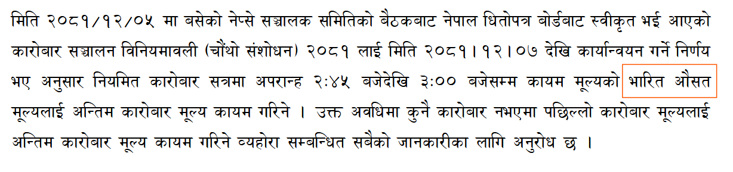




Closing Price Calculation

Slide 6
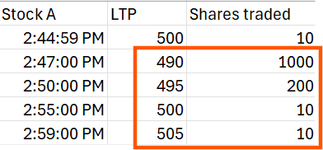
Example
Simple Price Average=(490+495+500+505)/4 = 497.5
Volume Weighted Average Price (Closing Price)=(490*1000+495*200+500*10+505*10)/1220=491.02

Slide 7
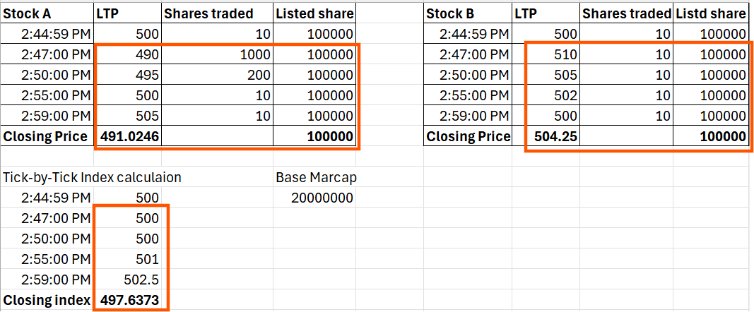
How Does It Affects Index (Suppose our index has two constituents Stocks A and B)
At 2:44:59
Index=((500*100000+500*100000)/20000000)*100
=500
At 2:47:00
Index=((490*100000+510*100000)/20000000)*100
=500
At 2:50:00
Index=((495*100000+505*100000)/20000000)*100
=500
At 2:55:00
Index=((500*100000+502*100000)/20000000)*100
=501
At 2:59:00
Index=((505*100000+500*100000)/20000000)*100
=502.5
Close index=((491.02*100000+504.25*100000)/20000000)*100
=497.63

Slide 8
Why is it Necessary to Calculate Closing Price?
Prevent Manipulation
Fair Representation of Market value
Reduce Volatility/Noise
Alignment with Global Best Practices

Slide 9
How Other Exchanges Calculate Closing Index
NSE & BSE (India)
VWAP of trades during the last 30 minutes of trade.
(sources: https://www.sebi.gov.in/legal/circulars/jan-2021/revision-in-daily-price-limits-dpl-for-commodity-futures-contracts_48720.html
https://groww.in/p/stock-market-timings)
NYSE (USA)
Close Auction
(Source: https://www.nyse.com/publicdocs/nyse/regulation/nyse-arca/NYSE_Arca_Rule_1.1.pdf)
London Stock Exchange (UK)
Close Auction
(Source: https://www.lseg.com/content/dam/ftse-russell/en_us/documents/policy-documents/closing-prices-used-for-index-calculation.pdf).

